Slide 1

Student details
Name : Chetashree Vijay Jagtap
Skills Build Email Id :cvjagtap18@gmail.com
Collage Name : Deogiri Institute of engineering and management studies
Collage state: Maharashtra
Internship Domain and internship Start and End date :12-06-2023 to 24-07-2023 Data Analytics

Slide 2

Problem Statement
The problem at hand is to perform a comprehensive analysis of a superstore's data to gain actionable insights and improve overall operational efficiency. The superstore has been experiencing various challenges, including declining sales, inventory management issues, and customer satisfaction concerns. The management team seeks to understand the underlying factors contributing to these problems and formulate data-driven strategies to address them effectively.

Slide 3

AGENDA
Introduction
Data Collection and Preparation
Exploratory Data Analysis
Inventory Management Analysis
Customer Behavior Insights
Sales and Marketing Strategies
Customer Satisfaction and Feedback
Future Growth Opportunities
Conclusion

Slide 4

PROJECT OVERVIEW
Introduction:
-The project aims to analyze sales data and derive insights to optimize profitability for XYZ Superstore, a retail company operating in the United States.
-By examining the dataset provided, we will explore various aspects of sales performance and profitability across different categories and regions.

Slide 5

Objective:
-The main objective of this analysis is to identify trends, patterns, and factors that influence sales and profit for XYZ Superstore.
-We seek to provide actionable recommendations to enhance overall performance and profitability.

Slide 6

Dataset Overview:
-The dataset consists of sales data for XYZ Superstore, covering various aspects such as ship mode, segment, country, city, state, postal code, region, category, sub-category, sales, quantity, discount, and profit.
-It encompasses transactions from different regions and includes information about consumer and corporate segments.
-The dataset allows us to investigate the performance of different product categories and sub-categories.

Slide 7
Key Analysis Areas:
Regional Sales Performance:
Identify regions with the highest and lowest sales figures.
Examine the contribution of each region to overall sales and profit.
Category and Sub-Category Analysis:
Analyze the sales distribution across different product categories and sub-categories.
Identify the top-performing and underperforming categories.

Slide 8

Profitability Analysis:
Investigate the relationship between discounts and profits.
Determine which product categories contribute most significantly to overall profit.
Customer Segmentation:
Segment customers based on their buying behavior and purchasing patterns.
Explore the impact of different segments on sales and profit.
Shipping Efficiency:
Evaluate the performance of different shipping modes in terms of sales and customer satisfaction.
Sales Trend Analysis:
Analyze sales trends over time to identify seasonal patterns and potential growth opportunities.

Slide 9

WHO ARE THE END USERS OF THIS PROJECT?
Retail Managers and Executives
Marketing Team
Inventory and Supply Chain Managers
Sales Team
Customer Service Team
Finance Department

Slide 10
YOUR SOLUTION AND ITS VALUE PROPOSITION
Efficiency and Speed
Comprehensive Analysis
Accurate Insights
Interactive Visualization
Actionable Recommendations
User-Friendly Interface
Continuous Learning

Slide 11

How did you customize the project and make it your own
Real Data and
Agenda and Analysis Plan
Custom Insights and Recommendations
Visualizations and Presentation
Consider Industry Trends

Slide 12
Modelling
In modelling I use python libraries for visualization.
Pandas,matplotlib,numpy this library are used for visualization.
Pandas library used for to convert csv file into the dataframe.
Matplotlib library used for data analysis and visualization.
Numpy library used for the numeric calculations.

Slide 13
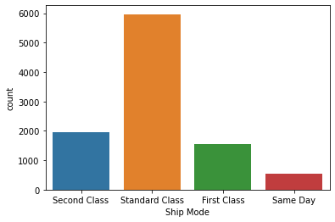
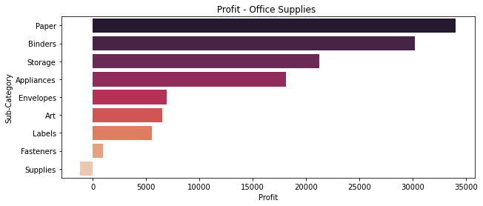
Results
Shipment method used in each region is mostly Standard class, so
obviously there is maximum sale in this shipment method.
Most profit gain by the in office supplies is paper.

Slide 14
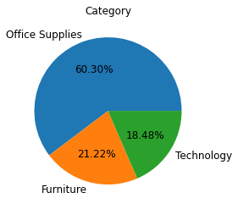
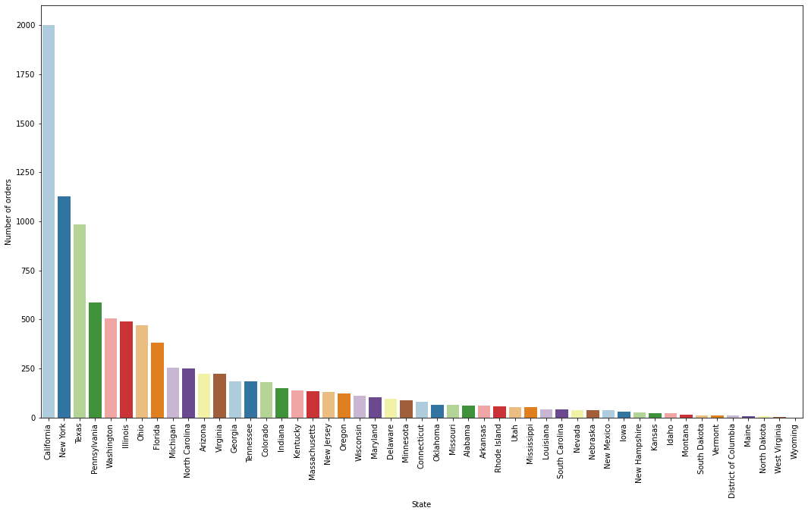
percentage of office Supplies is 60.30%
Furniture perecentage is 21.22%
Technology perecentage is 18.48%
This graph is showing that highest number of orders state and that is California.

Slide 15
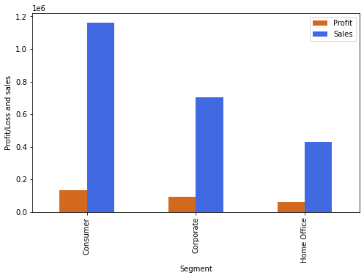
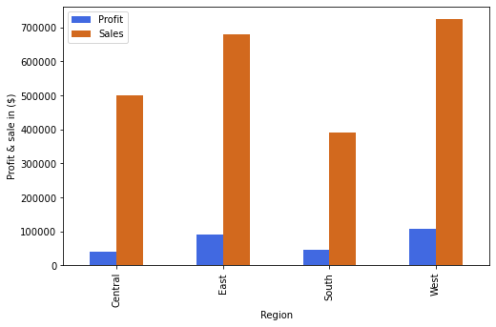
In this graph we analyze that highest sale and highest profit
Gain by the consumer.
In this graph we analyze that highest sales and highest profits
Is taken by west region and after that east region.

Slide 16
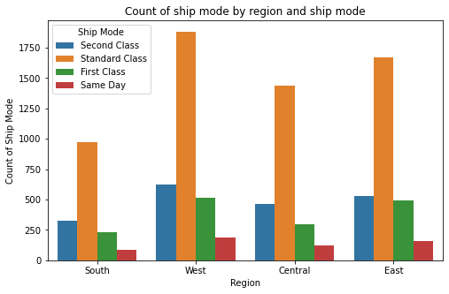
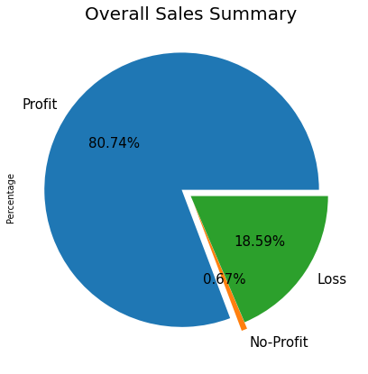
Standard class is used in each region and highest
count of standard class is in west region.
Overall summary states that 80.74% we gain by profit and
18.59% we gain by loss and 0.67% no profit and no loss

Slide 17
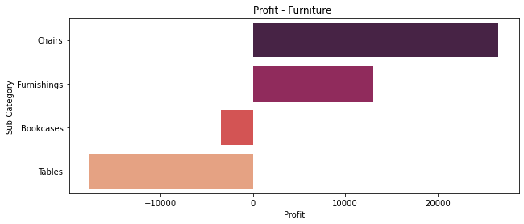
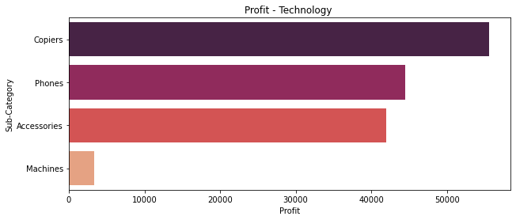
Highest profit gain by in furniture section is chairs.
Highest profit gain by in technology section is copiers .

Slide 18
Links
https://github.com/Harshalzarikar/skillbuild
https://www.kaggle.com/datasets/bravehart101/sample-supermarket-dataset/code

Slide 19
THANK YOU

